Slide 1
IMPACT ASSESSMENT: THE NIZAMUDDIN URBAN RENEWAL INITIATIVE
Submitted by: Arushi Sahay
Shubhlaxmi Ray
Sukriti Bakshi

Slide 2
The urban renewal project undertaken by the Aga Khan Trust for Culture (AKTC) provides a model for civil society engagement in urban development.
HYPOTHESIS:

Slide 3
RATIONALE BEHIND THE TOPIC
Micro-level implications of such a large scale project
Politics behind the idea of ‘urbanization’
Analysis of the socioeconomic impacts on the beneficiaries of such a project
A comparison of the reported and the actual consequences of the project

Slide 4
METHODOLOGY
Universe: Nizamuddin Basti
Fieldwork over 3 days
Sample Type: Residents, shop owners and officials (20-25 people)
Sampling Method: Random Sampling
Methodologies: Participant and Non-Participant Observation, and Unstructured Interview

Slide 5
We opted for these methods as our aim was to gain the opinions and experiences of the people involved
We were dealing with a largely non-English speaking population
We recognised the importance of subjective answers and subliminal cues in the kind of data we were collecting

Slide 6
REVIEW OF LITERATURE
“Nizamuddin Urban Renewal Initiative Annual Report” Aga Khan Development Network, 2015
“Urban Renewal Initiative Project Brief” by AKTC, March 2013
“Development in the Context of Urban Conservation: Examining the interrelationship between the architectural heritage and intangible culture in historic settlements” Bhavin Shukla
“Finding Workable Solutions to the Issues Adversely Affection the Preservation of Built Cultural Heritage in India, Prashant Banerjee, January 2015
Media sources such as Times of India, Business Standard, The Better India, Firstpost, Indiatimes etc.

Slide 7
The Project Report(s) by Aga Khan
The People Public - Private Partnership model and its implications
Major focus areas of health, sanitation, and education and employment
Committees and groups formed; their functions and benefits
Empowerment of the residents in their everyday lives
Aestheticization and beautification of the Basti complex

Slide 8
Data Analysis and Interpretation
Henceforth we aim to compare the information that we gathered from the reports with what we gathered from the field.

Slide 9
People Public - Private Partnership
The idea of civil society engagement was central to the project:
Step by step engagement
Micro level participation
Community initiatives
Participation in restoration process
Revival of traditional crafts and culture

Slide 10
However, on the field, one finds such engagement only at superficial levels:
Residents were approached only with a general plan, ideas of better lifestyle and more employment opportunities
They were not involved at an intimate level, for feedback programmes or in the official functioning of Aga Khan
Essentially, how the project has panned out over the years is very different and distant from people’s expectations

Slide 11
Health
Polyclinic: Run by the government v/s run by AKTC
Mother and child care
Community outreach programs: malnutrition, household check ups
Immunization drive
Substance abuse

Slide 12
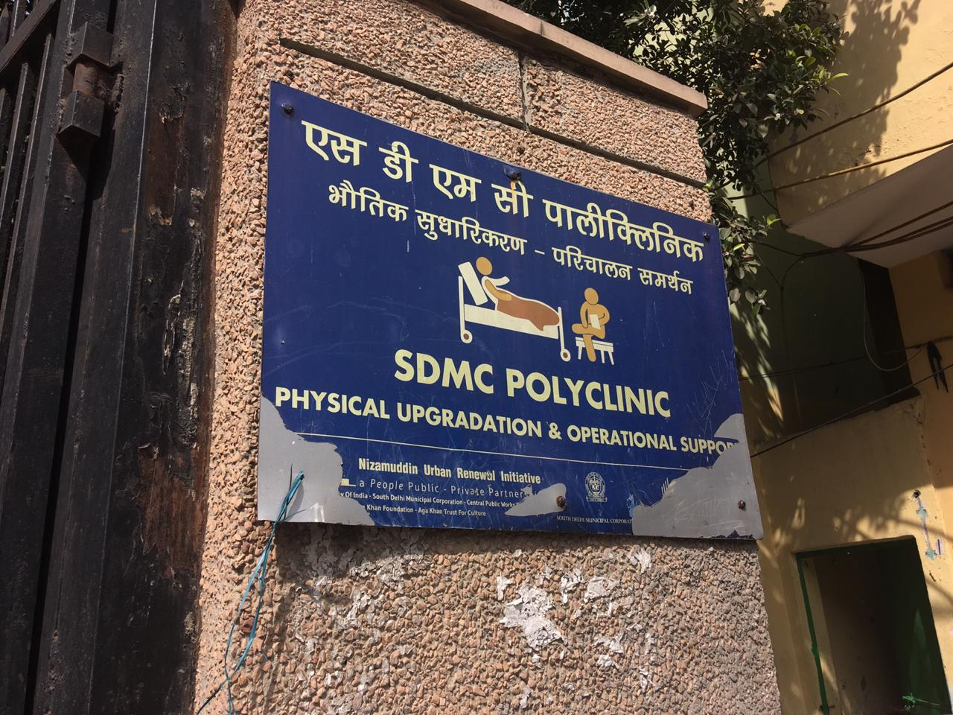

Slide 13
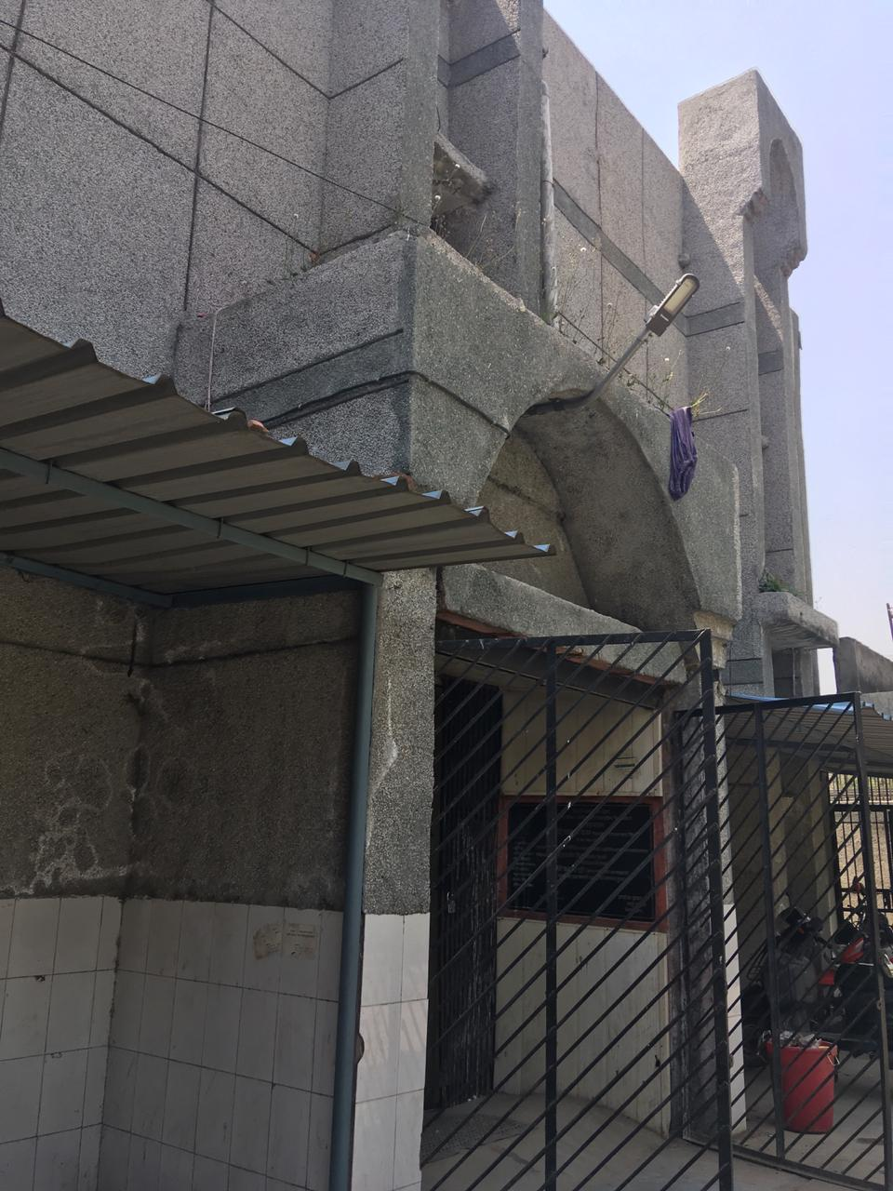

Slide 14
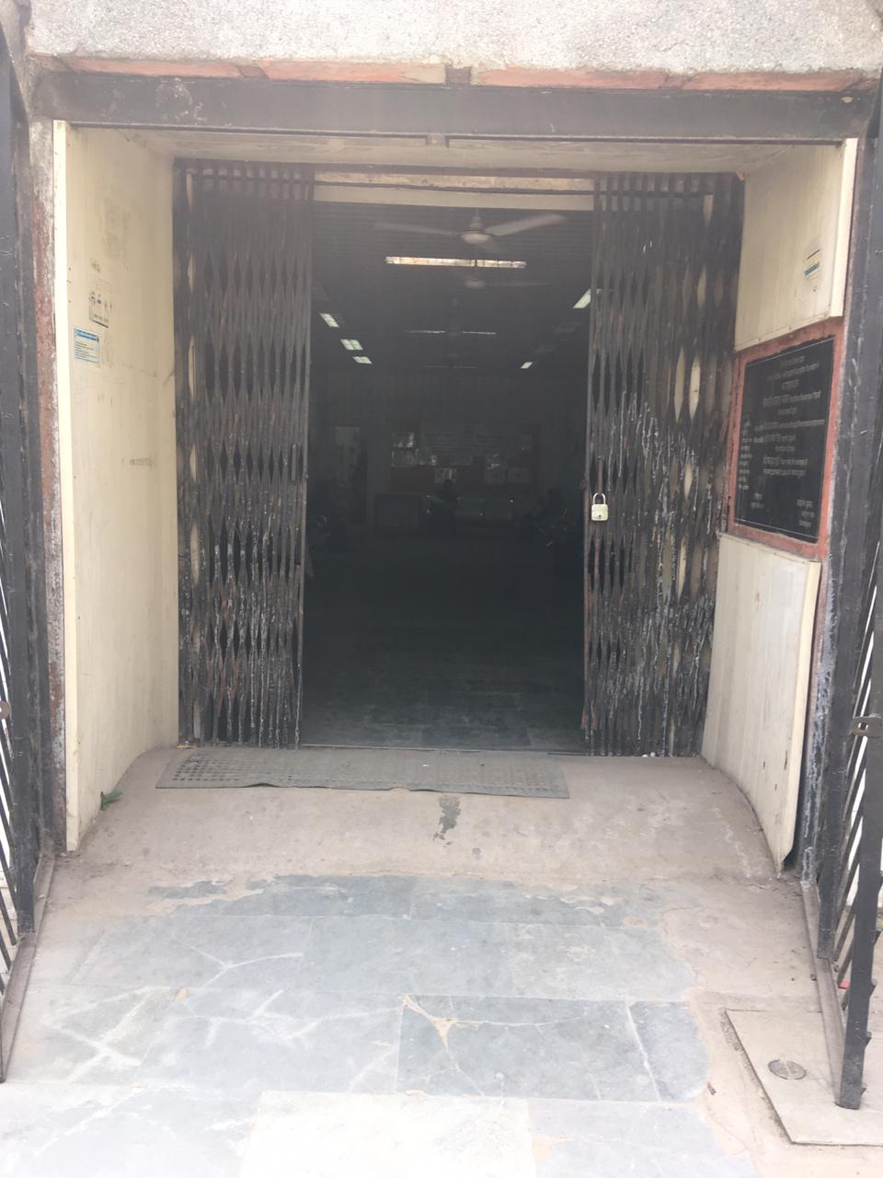

Slide 15
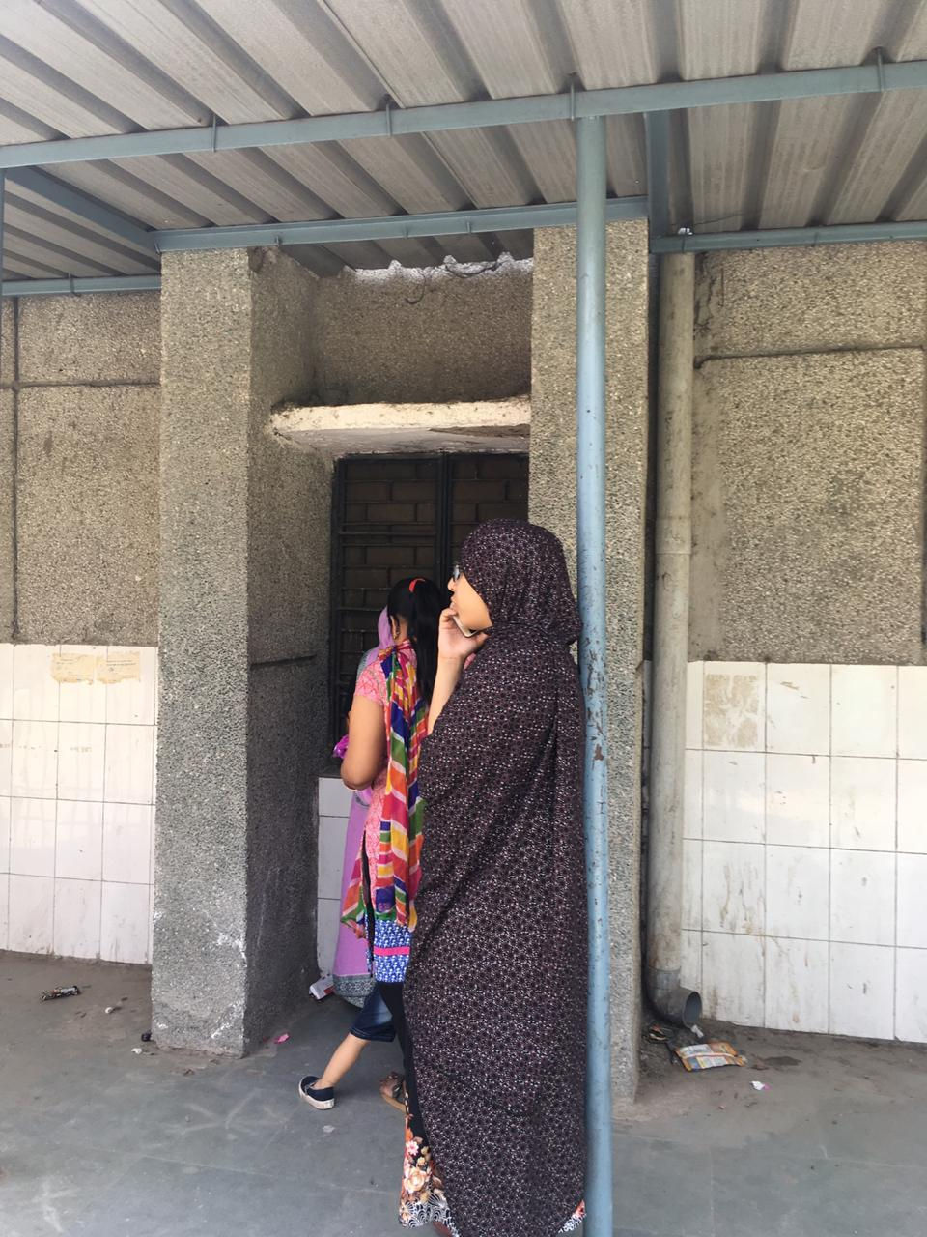

Slide 16
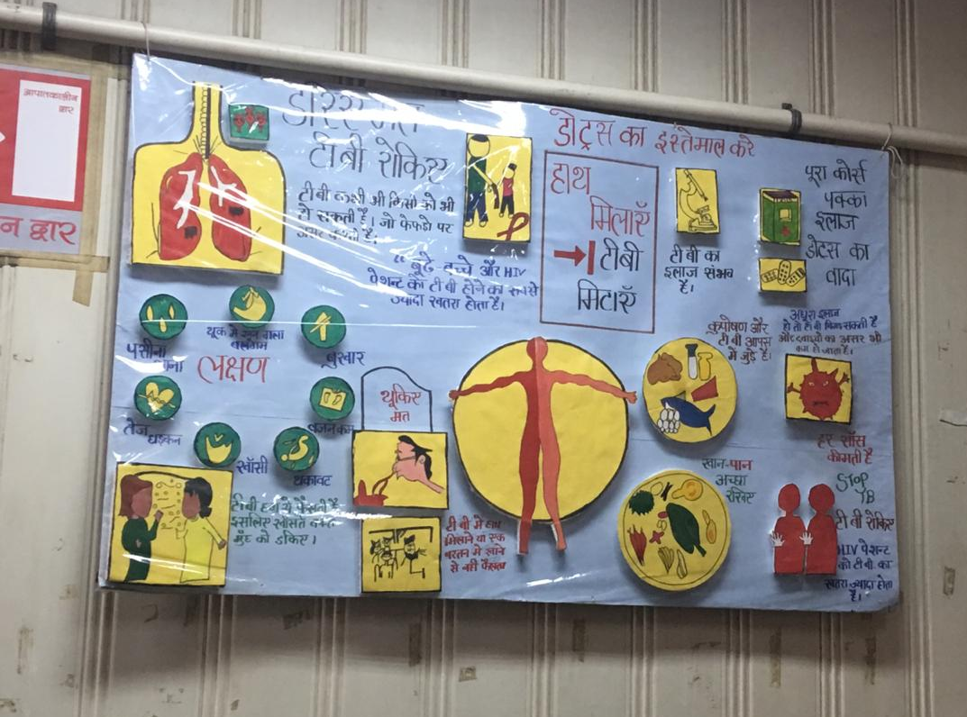

Slide 18
Sanitation
Toilets: Took over maintenance of public toilet, introduced charges, discontinuation of family card scheme
Waste collection: Regular and satisfactory
Sewage and drainage: Improvement concentrated around certain areas, open drains in the rest; generally better under the government

Slide 19
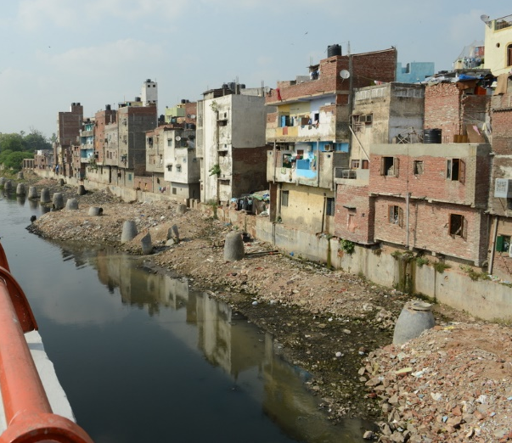
Picture Credits: nizamuddinrenewal.org

Slide 20
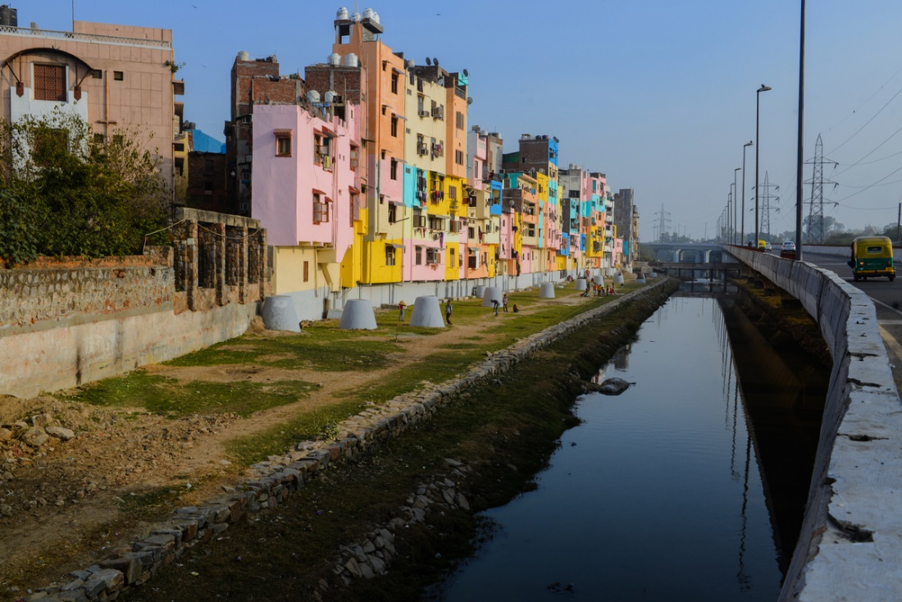
Picture Credits: nizamuddinrenewal.org

Slide 21
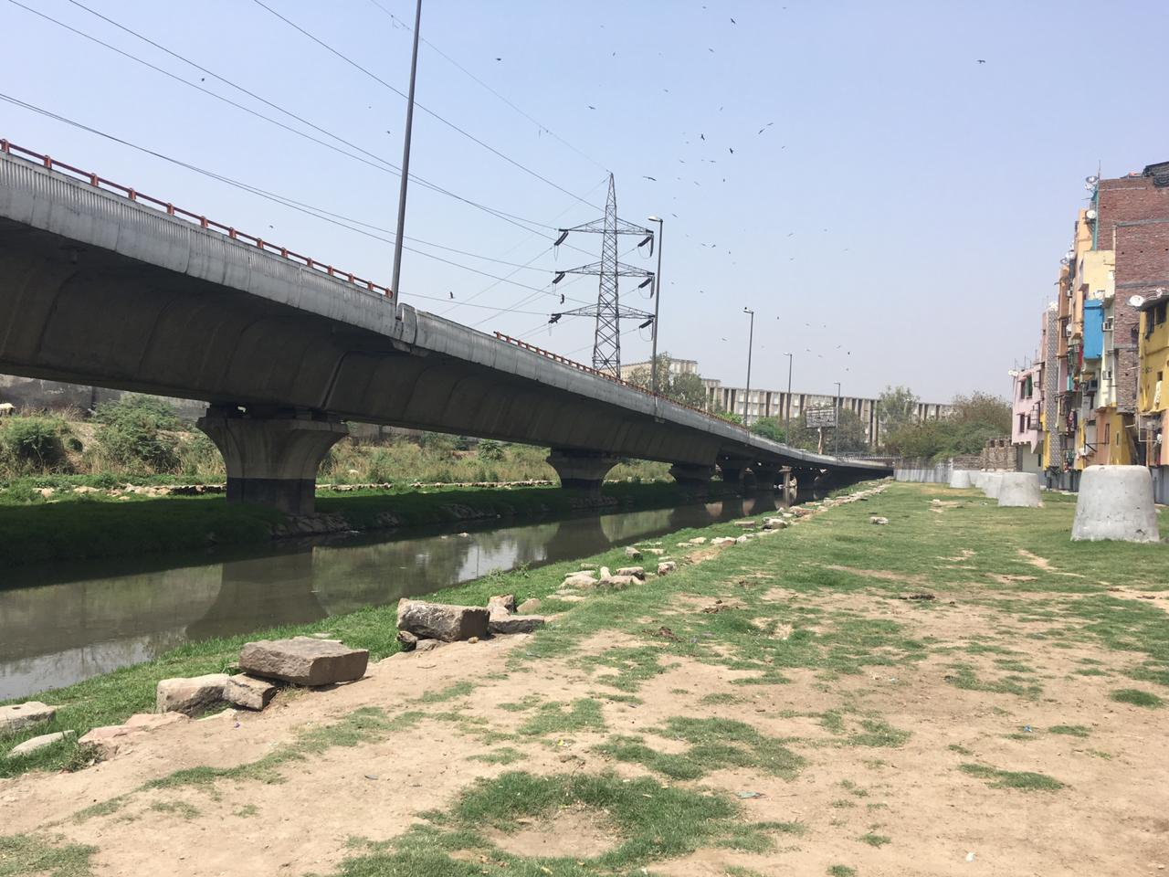

Slide 22
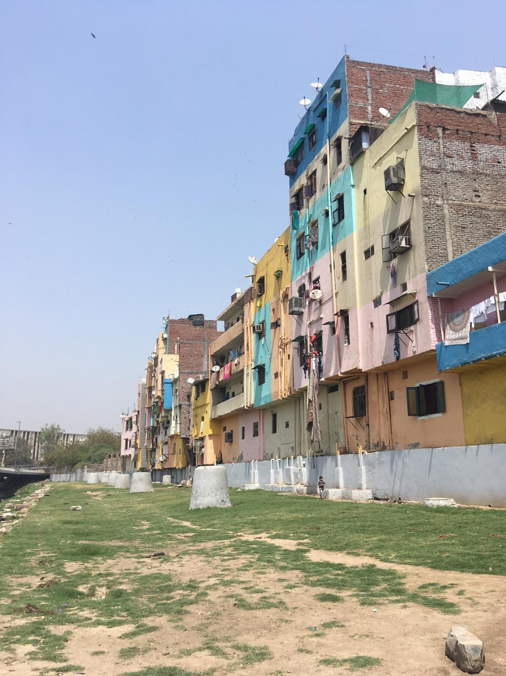

Slide 23
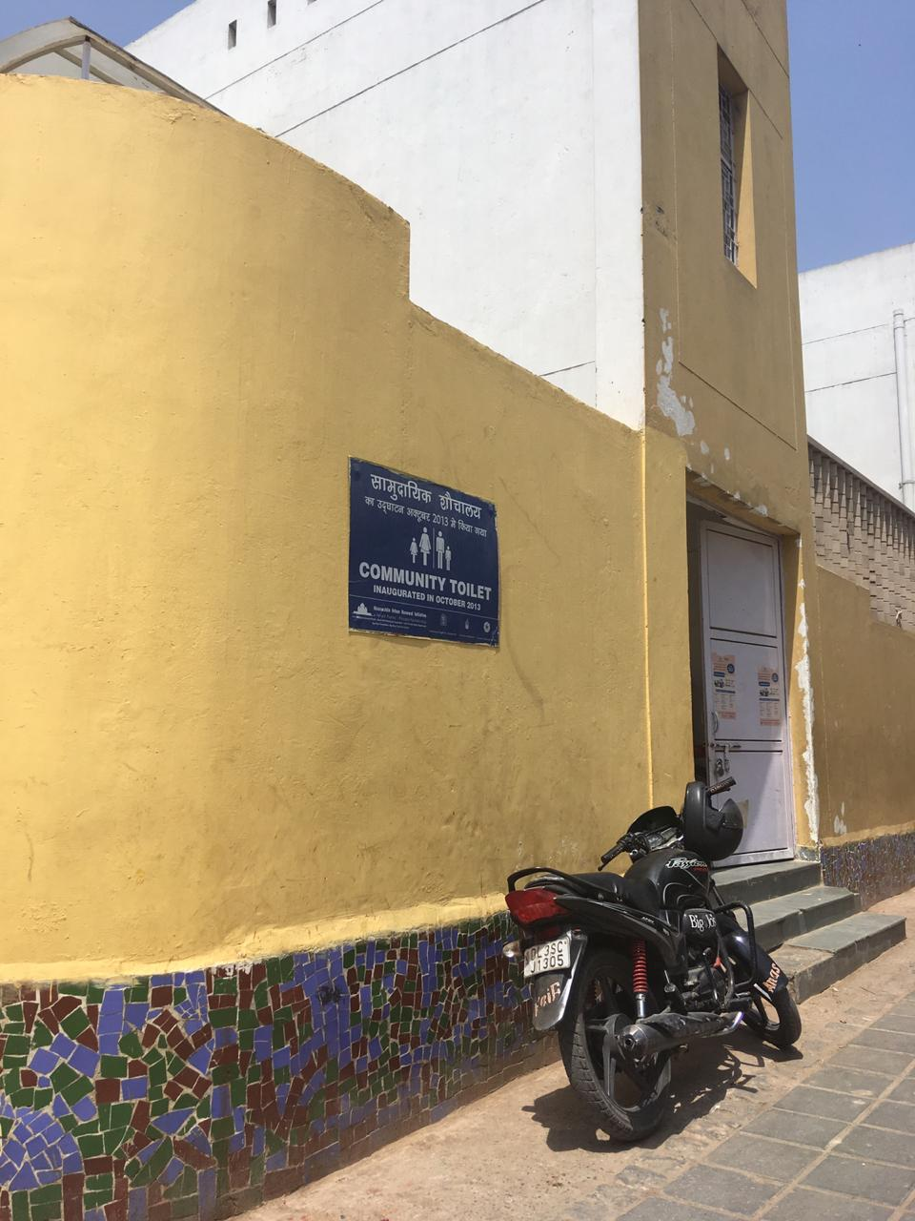

Slide 24
Education and Employment
SDMC School, Nizamuddin West: Happier when run by the government; enrolment and attendance; parental involvement; computer facilities
Chintan and Hope Projects
Vocational training: certificate and training programs, subsequent employment generation; beneficial only to a few
Employment in the restoration project

Slide 25
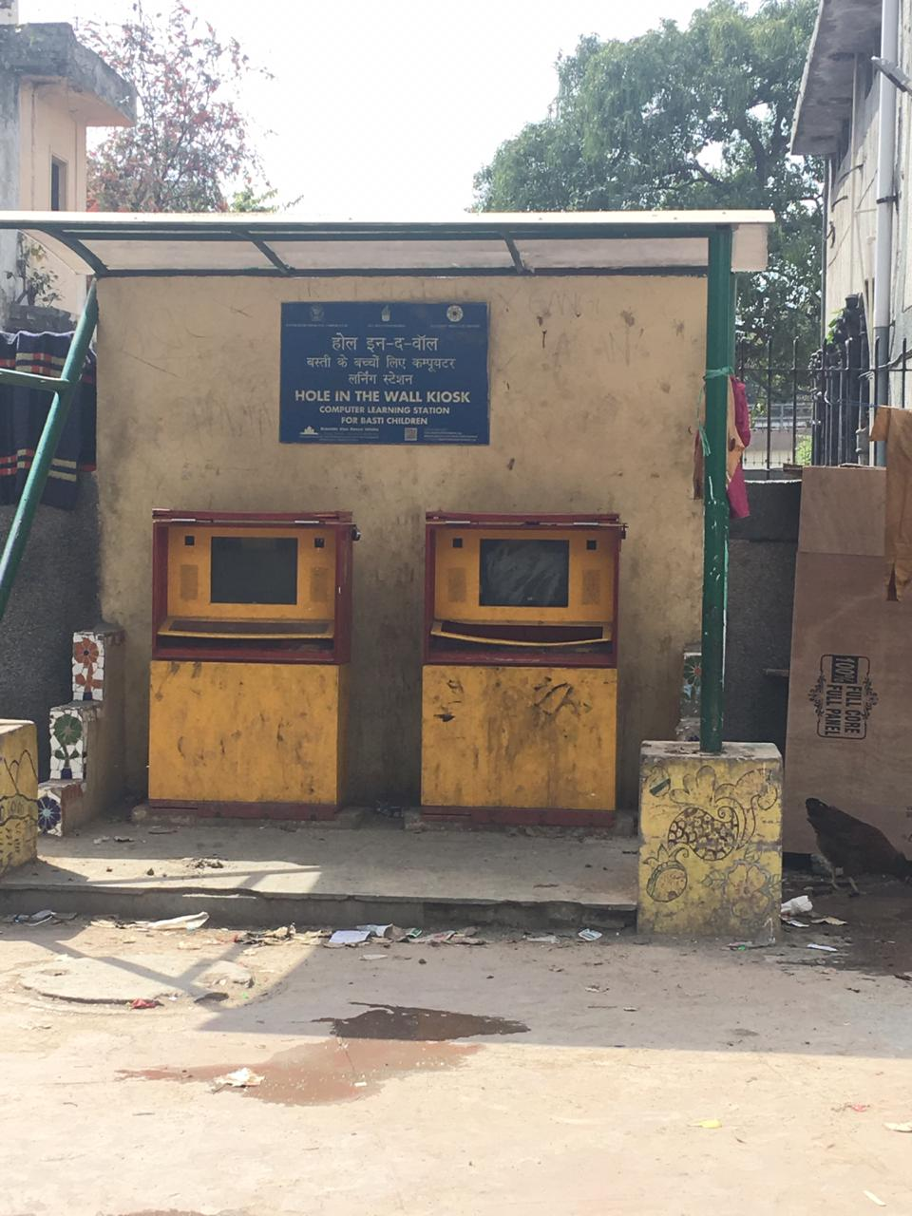

Slide 26
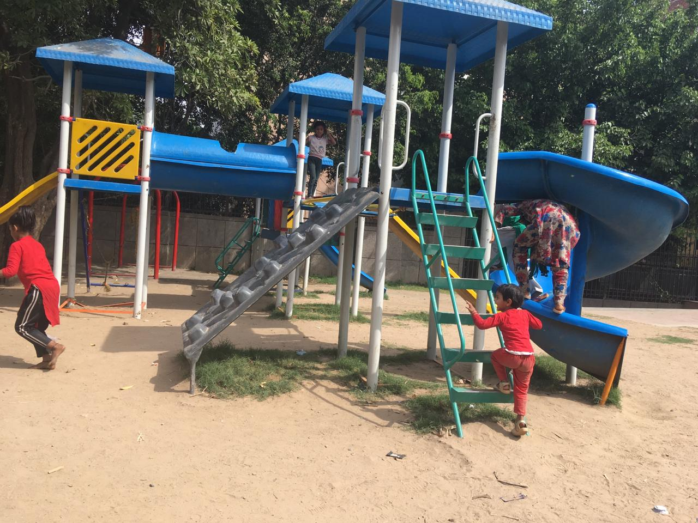

Slide 27
Committees and Groups
Self Help Groups: Insha-e-Noor (women employment), Zaika-e-Nizamuddin (malnutrition), and Sair-e-Nizamuddin - limited and biased employment generation
Rehnumai resource centre: Information and assisstance regarding government policies like adhaar card scheme
Rehman Nigrani Samooh (RNS): Waste collection
Mohalla Health and Sanitation Committee (MHSC)
Apni Basti Mela

Slide 28
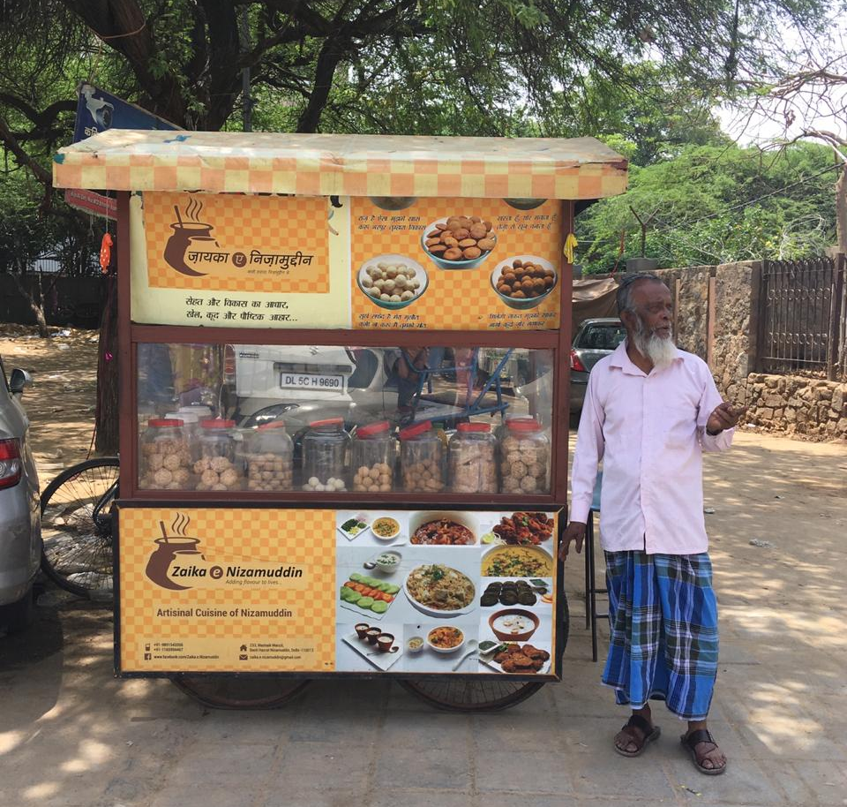

Slide 29
Empowerment of the Residents
Overall improvement of the quality of life:
Dignity of work and labour
Confidence and self esteem, specially among women
Financial independence and sustainability
Pride in their own cultural history
However, due to the lack of accountability of the foundation, and the disparity between the vision of the people and that of the foundation has majorly hindered the empowerment of the people.

Slide 30
Aestheticization and Beautification
Development of open spaces such as parks
Offices of the AKDN: Big and brightly painted buildings in the middle of the Basti
Boards bearing the Project’s name placed around the Basti
Installation of computer kiosks (non- functional)
Street cleanliness: Tiles, regular sweeping, dustbins

Slide 31
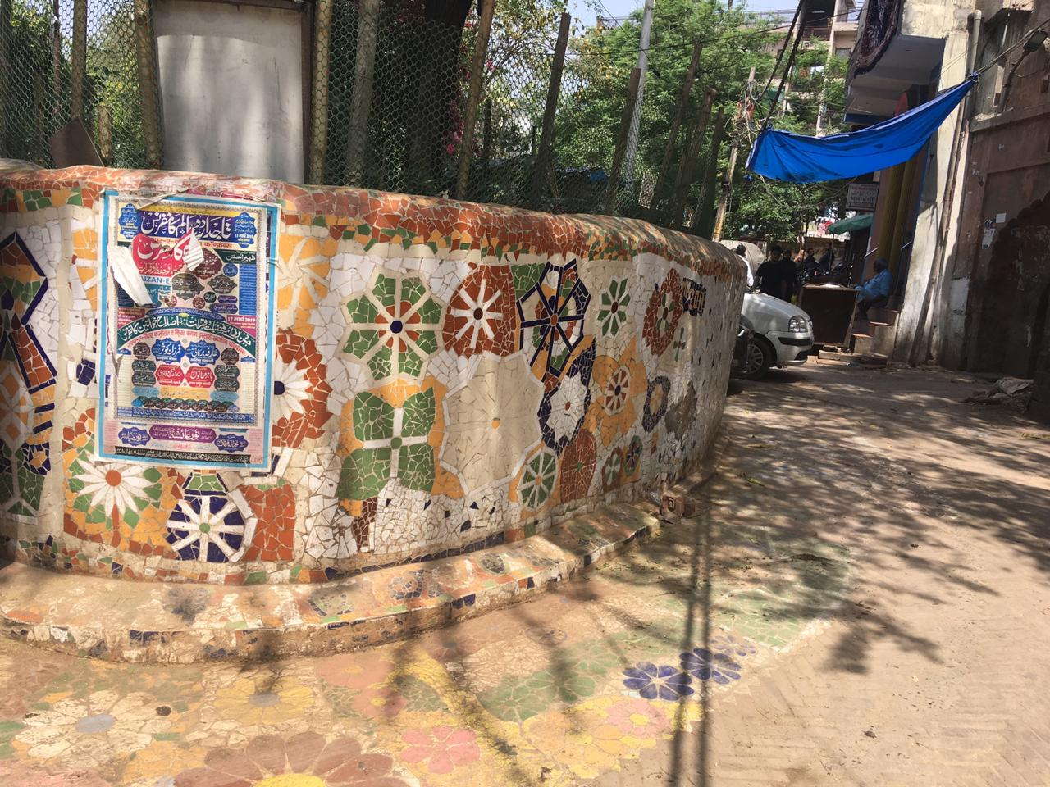

Slide 32
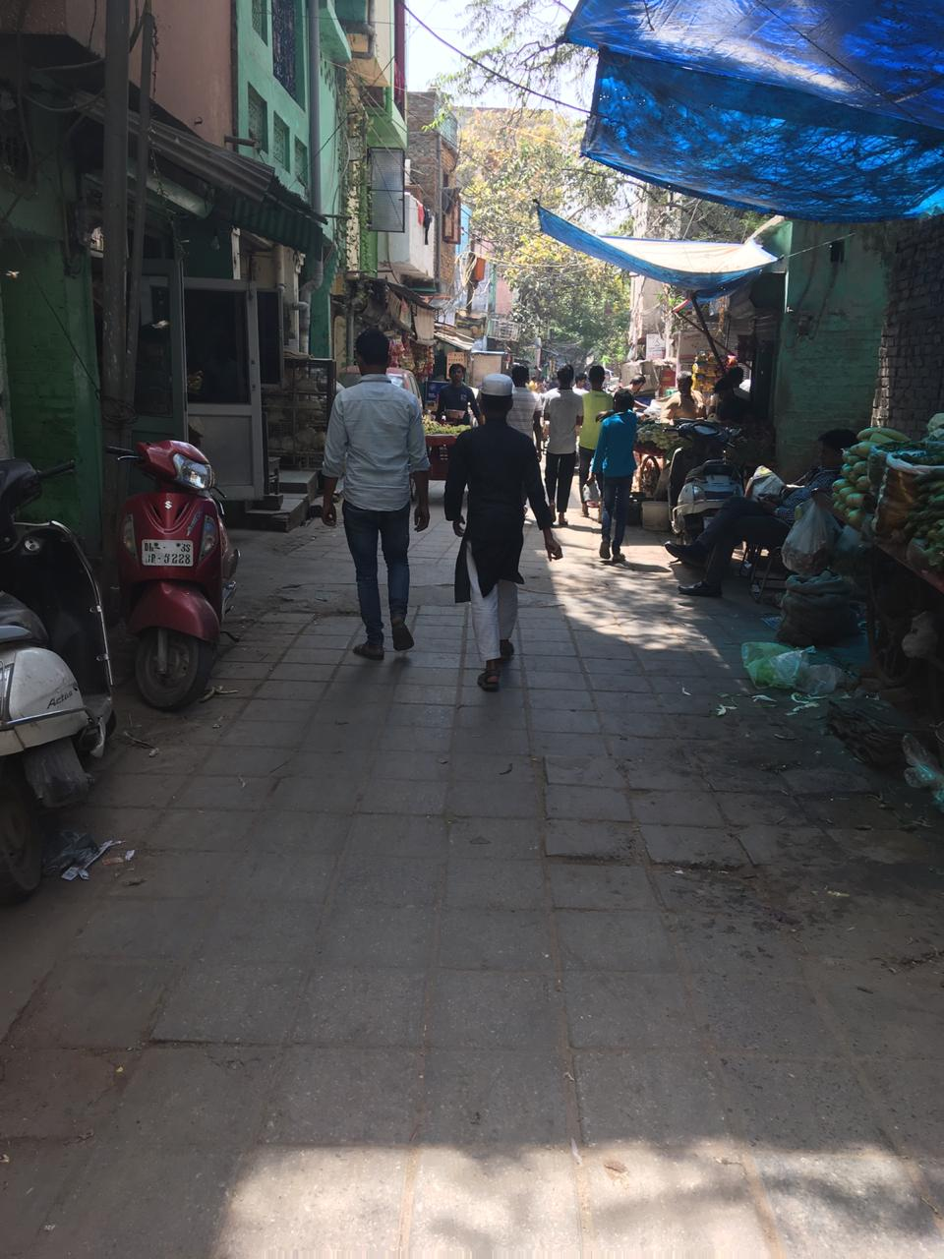

Slide 33
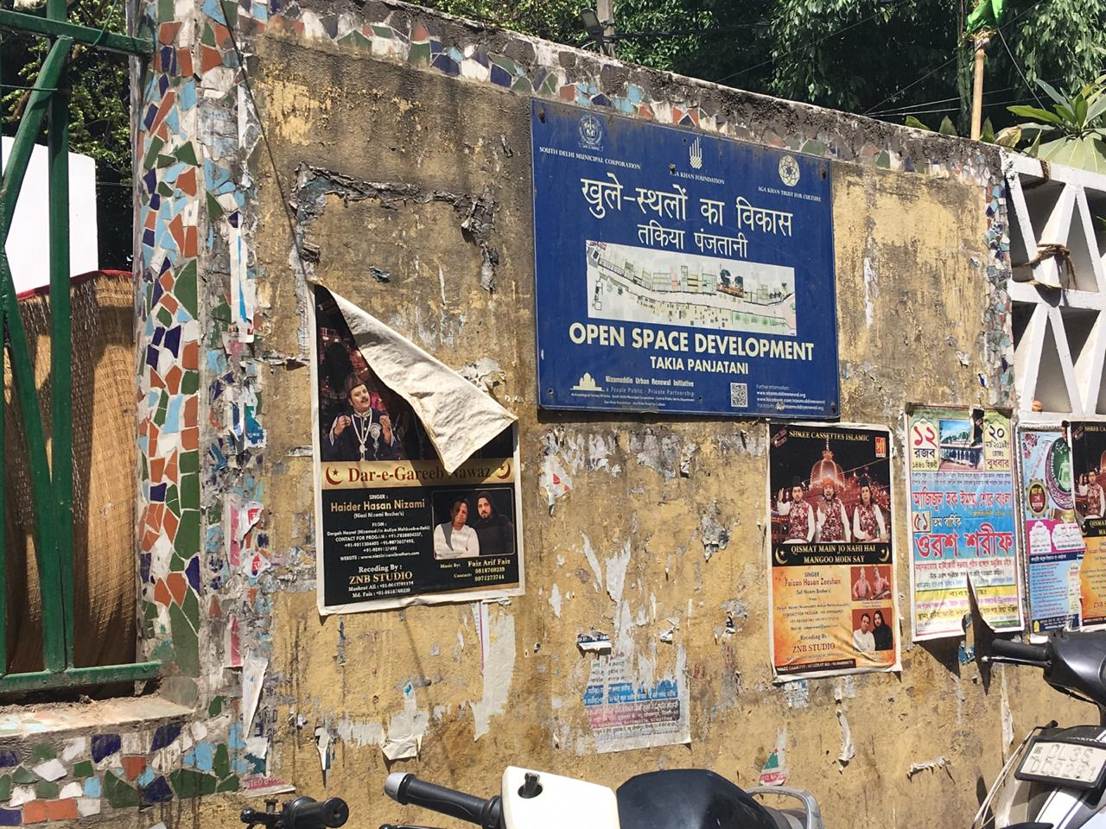

Slide 34
FINAL ANALYSIS
Improved cleanliness
Employment generation
Regular health check ups
Functional SHGs

Slide 35
Lesser accountability as compared to the government
Intervention by a foreign private body - overwhelming presence, Foucauldian idea of surveillance
Home versus heritage – ujaad, kabza
Disparity in the meting out of benefits – economic status, residential status, and location of the house
Gaps in the vision of development and urbanisation
Another form of capitalism; alienation of the beneficiaries themselves

Slide 36
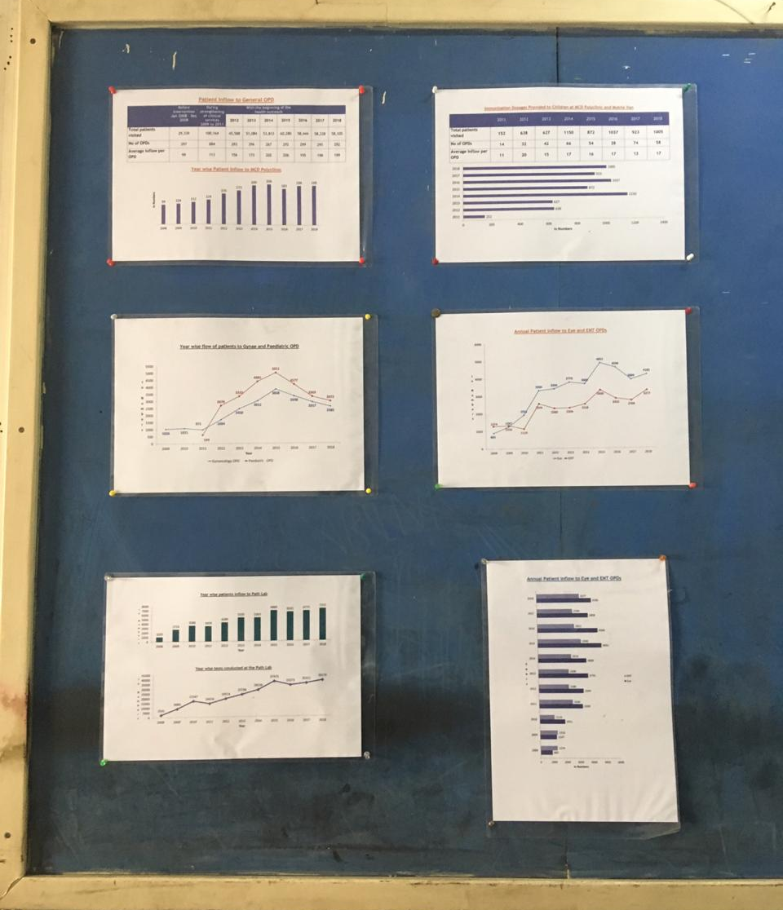

Slide 37
Methodological Barriers: Our Experience in the Field
Socioeconomic between us and the field
Our gender identity – The madam, gudiya label
Hesitation of the residents in talking about Aga Khan Foundation
Silence of the Aga Khan Foundation and their Officials in the Basti
Our inhibitions and the sensitive nature of our topic
We tried our best…

Slide 38
Conclusion
Thus, our fieldwork unveiled to us the glaring gap between the project report of AKTC and the several media reports, and the realities that existed in the Basti
While a decent amount of work has happened in the Basti, the major idea of civil society engagement has largely failed
A project that was started with the idea of a unique way of urban renewal that takes the people as significant nodes in the process of development ends up on field as an imposed idea of urbanization on an alienated population
Hence, our hypothesis stands disproved.

Slide 39
