Slide 1
Effects of Demonetization on Small & Medium Enterprises

Slide 2
INTRODUCTION
In 2016, the Indian government decided to demonetize the 500 and 1000 rupee notes, the two biggest denominations in its currency system; these notes accounted for 86% of the country’s circulating cash.
The government’s goal was to combat India's thriving underground economy on several fronts: eradicate counterfeit currency, fight tax evasion, eliminate black money gotten from money laundering and terrorist-financing activities, and to promote a cashless economy.
A large section of the society was forced to move to cashless-digital alternatives to fulfill their daily needs.

Slide 3
DEMONETIZATION: An Overview
Demonetization is the act of stripping a currency unit of its status as legal tender. It occurs whenever there is a change of national currency. The current form or forms of money is pulled from circulation and retired, often to be replaced with new notes or coins. Sometimes, a country completely replaces the old currency with new currency.
The Indian government has demonetized bank notes on two prior occasions—once in 1946 and then in 1978—and in both cases, the goal was to combat tax evasion by "black money" held outside the formal economic system.
The process of demonetization in November 2016 made an impact in all major sectors of the country like Banking, Railways, Stock Markets, Transportation and Agriculture.

Slide 4
Small, Medium and Large Businesses – The Difference
Basis of Difference | Small Businesses | Medium Businesses | Large Businesses
Equity share | Equity held by Founder / Family | Mostly Privately held – Family or Founder (limited public involvement) | Most Public investor – held equity
Management | Owner-managed | Owner and Professionals in key roles | Professional Management
Decision Making | Largely by the owner | It is done by owner and a few key leaders (single/dual) | Organizational Hierarchy
Planning | Short-term planning | Some long-term planning | Extensive long-term planning
Structure & Operation Processes | Informal structure, where mostly founder gets things done | Some formal processes and other informal processes, where both the founder and key executives get things done | Formal and independent structure and processes
Capital needs | Most capital needs are met by leveraging personal net worth | Limited sources of capital, some hard to access | Wide range of funding sources
Customer base | Small – generally local markets | Limited customer base – limited to geographical or industry niche | Diverse markets (many global) with diverse customers.
Personnel Development | Limited personnel development opportunities | Limited to key employees | Multiple career development paths and programs
External input | Limited to friends and family | Little external input – mostly from friends, network and trusted professionals | Significant external inputs – from network and consultants; have separate governance structure
Investment | In Plant and Machinery - More than twenty-five lakh rupees but does not exceed five crore rupees. In Service & equipment – More than ten lakh rupees but does not exceed two crore rupees | In Plant and Machinery – More than five crore rupees but does not exceed ten-crore rupees In Service & equipment – More than two crore rupees but does not exceed five crore rupees | In Plant and Machinery- More than ten crore rupees In Service & equipment- More than five crore rupees

Slide 5
DIGITALIZATION – AN ALTERNATIVE TO CASH ECONOMY
Demonetization can also be referred to as the process of moving people from a cash-based system to a cashless system (digital systems).
The cashless system or electronic system which records the transactions through digitalized mechanisms for safer flow of money in the economy is referred to as Digitalization.
It is the integration of digital technologies into everyday life by the digitization of everything that can be digitized. The literal meaning of digitalization gives an apparent idea of development and technology dependent world.

Slide 6
OBJECTIVES
The aim of defining demonetization, Small and Medium Enterprises and digitalization is important in order to understand the following:
To determine whether demonetization had a detrimental effect on Small and Medium Enterprises.
Whether it forced Small and Medium enterprises to go digital and if that helped business in smoother functioning.
To determine the problems that arose due to the introduction of a larger denomination note (2000 rupees) and how SME owners dealt with these problems.
Our hypothesis is that demonetization has had a detrimental effect on small and medium scale businesses in the short term

Slide 7
Review of Literature:
A review of the concurrent literature allows an expansion of knowledge and resources with regard to the study. The following academic texts, articles and research papers are useful in explaining the degree and nature of the impact of demonetization among small-medium enterprises :
“The Informal Sector as a Global Economy” by Jan Bremen
Article “Modi’s Demonetization Move May Have Permanently Damaged India’s Informal Sector” by Pronab Sen, Country Director for the India Central Programme of the International Growth Centre (Nov. 2016)
Report titled “Effects of Demonetization on Retail Outlets” by Geeta Rani, Associate Professor, B.P.S.M.V. KHANPUR (International Journal of Applied Research 2016; ISSN Print: 2394-7500)
Research Paper titled “Impact of Demonetization in India” by M. Angel Jasmine Shirley, M.C.A., M.Phil., M.Ed., (Ph.D.), Maharishi University, Lucknow (International Journal of Trend in Research and Development (IJTRD); ISSN: 2394-9333)
Research Paper titled “DEMONETIZATION AND ITS IMPACT ON INDIAN ECONOMY” by SK Govil (Journal of Management Value & Ethics, Jan-March 17; ISSN-2249-9512)

Slide 8
Methodology Adopted
METHODOLOGICAL FRAMEWORK
This study was carried out to determine whether demonetisation had a negative impact on SMEs and whether this move by the current government inadvertently led to greater digitalisation.
The study was undertaken by holding structured interviews with the owners of various SMEs in different parts of South Delhi.
The sample was taken from various markets like Satya Niketan, Bapu Dham and Sarojini Nagar and was made as representative as possible. The interviewees included owners of grocery stores, cloth shops, food vendors, small restaurants, stationary shops etc.

Slide 9
SAMPLING FRAMEWORK
Sampling Technique: The sampling techniques that were adopted were of two kinds.
PURPOSIVE SAMPLING - A purposive sample is a non-probability sample that is selected based on characteristics of a population and the objective of the study. The markets mentioned above were specifically chosen because of the diversity of SMEs that operate within these.
SIMPLE RANDOM SAMPLING - This means that within the markets chosen, each SME owner had an equiprobability of getting selected.
Sample Size: The total size was 30, spanned across small and medium enterprises.
Tools of Data Collection:
Primary Data was made by making qualitative evaluation by leveraging subjective methods such as structured interviews in community settings to collect substantive and relevant data. Extensive personal interviews were carried out over a period of two months.
Both qualitative and quantitative methods were used to analyse the data collected.
The methods of structured interviews and case study were used for this study

Slide 10
Indicators Used
Effect of Demonetisation on:
Revenue- Supply of Raw Material
Demand of Final Good
Salary of employees
Shift to Digital methods of Transactions
Voluntary
Incentivised
Refused
Pre-existing
Digital Payment Gateways (refers to whether these were still used post the initial phase of demonetisation)
Credit/Debit Cards
Digital Wallets
Problems regarding the 2000 rupee note
Change issues Counterfeit notes
Duration of effective usage of digital transactions
Less than 1 month
1-3 months
More than 3 months

Slide 11
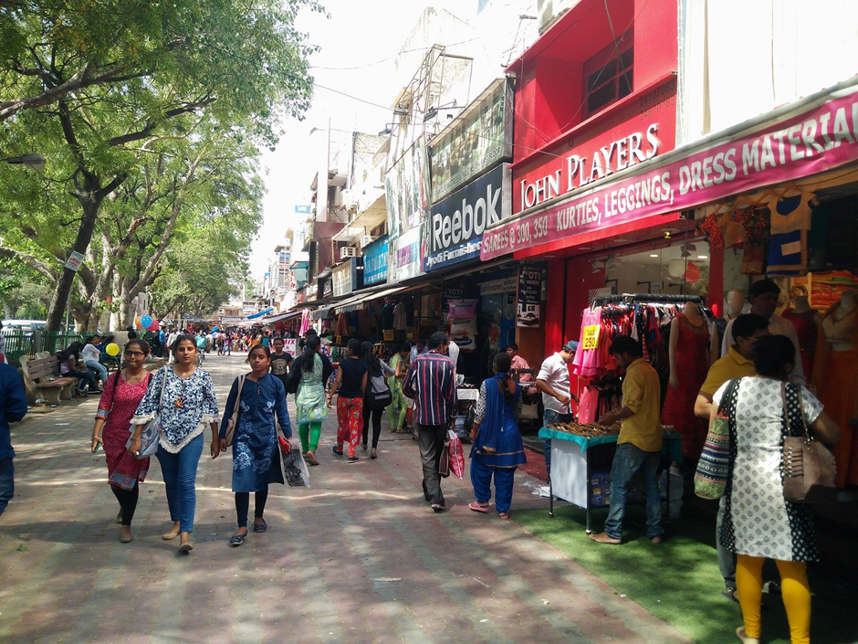
Introduction to the Field
The universe of our study is South Delhi. South Delhi is an administrative district of the National Capital Territory of India.
It was decided to carry out the study in the markets of Bapu Dham, Sarojini Nagar (a neighbourhood and market in South West Delhi) and Satya Niketan. These were chosen because of the variety and diversity of small and medium sized businesses that operate here.
The team had access to every type of business, ranging from small food vendors to local clothes shops. Data was also collected from those running small businesses within Jesus and Mary College, Chanakyapuri.

Slide 12
Dilemmas and Problems Faced in the Field
During the entire process, we faced some resistance from our subjects as they were unwilling to answer questions and allot time to the team.
There were certain questions regarding revenue and sales that they were unwilling to answer. However, with time, the team learnt to frame these questions better so as not to offend the subjects even in the slightest way.
The interviewees often got carried away and went off topic. Also, sometimes they interpreted the questions in a way other than what was intended and it became difficult to get the required information out of them. However, over a period of time, we learnt how to conduct these interviews smoothly.
Sometimes, there was a language barrier and the team had to try multiple times before we could put across our questions in the way intended.

Slide 13
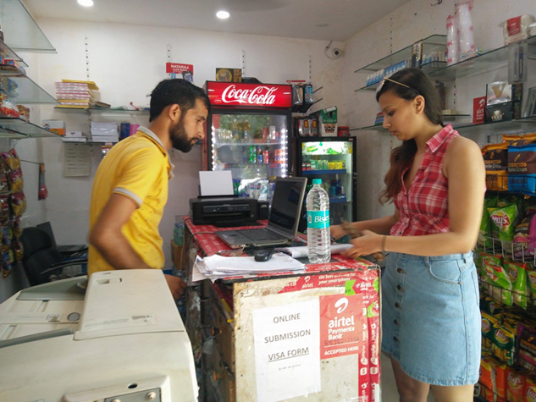
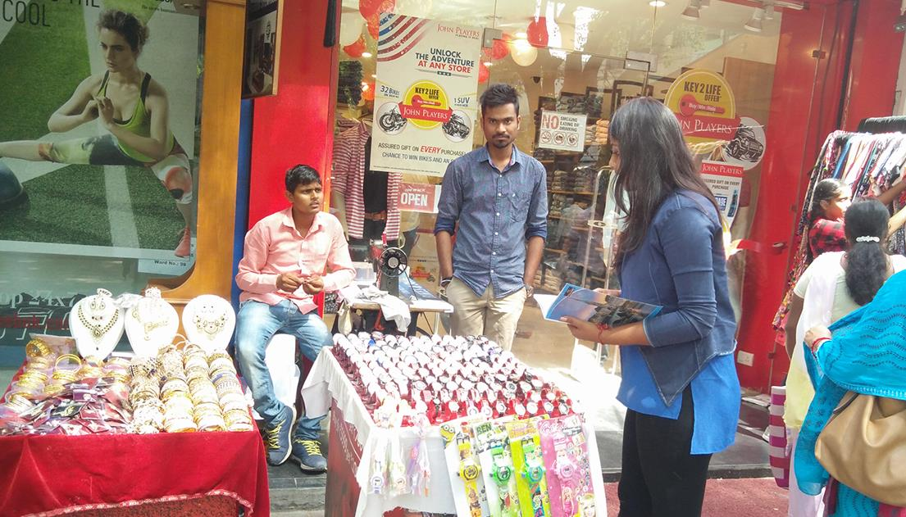
Dilemmas and Problems faced in the Field
Interviewees often resorted to impression management and tried to provide information that was incorrect.
Interviewees were often suspicious of the nature of our research, but this problem was alleviated after we showed them our college IDs.
As a researcher, we had to face the struggle of maintaining objectivity and value-neutrality at all stages of research.

Slide 14
AN EMPIRICAL ANALYSIS: DEMONETISATION AND ITS SOCIO-ECONOMIC EFFECTS Detrimental Effect of Demonetization

Slide 15
Shift to Digital (Non-Cash Based) Methods of Transaction

Slide 16
Digital Payment Gateways

Slide 17
Demonetization disadvantage the SMEs more than the larger businesses?

Slide 18
Consequences of the New 2000 Note

Slide 19
Duration of the Effective Usage of Digital Methods of Transaction

Slide 20
Observations
When demonetisation was announced, digital wallets such as PayTM targeted markets like Sarojini Nagar. They carried out surveys there and encouraged SME owners to shift to digital methods of transactions. A majority of SMEs had PayTM as an alternative to cash.
SMEs reported that customers only used digital wallets during the initial phase of demonetisation, when the new currency wasn’t properly in circulation. As soon as they had access to the new 500 rupee note and circulation normalised, customers went back to cash transactions.
In fact, many SME owners got rid of mobile wallets because customers started using this facility to get cash in exchange for digital money.
In order to deal with issues regarding change for higher denominations, SME owners started paying high rates for bundles of smaller denomination notes. Many who didn’t resort to this had to turn away customers who tried paying with 2000 rupee notes for purchases that amounted to less than 500 rupees.
Many of the smaller businesses did not shift to digital transactions because they did not know how to use the technology. The government should have educated and informed the population about how to deal with digitalisation when they decided to demonetise.
When asked about their opinions on the current government and its policies, many SME owners seemed to think that agreeing with whatever the government officials say is what is best for them.

Slide 21
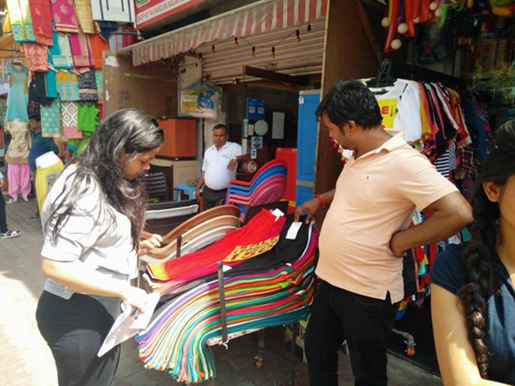
Observations
A majority of SME owners were of the opinion that demonetisation was a success despite the short-term inconvenience caused to the population. They also said that such moves by the government from time to time are beneficial in the long-term. However, they also said that the implementation should have been much better and that they were blindsided.
Most SMEs were family run businesses and the current generation running them seemed to be resigned to their role of continuing the family business. Those who had sole proprietorship and had started the SME on their own seemed more enthusiastic about their work.

Slide 22
Conclusion
From this study, it can be concluded that the effect of demonetisation on this sector and economy were detrimental. However, the presumed connotations associated with the negative impacts of this ban were not of the severity that was sensationalised by the media. The change did cause a hindrance in the business but digitalisation was helpful in overcoming it to a certain extent.
Digitalisation as a concept did percolate through the small medium enterprises as a viable alternative through the initial phase. Nonetheless, its sustainability is still under questionable since consumers went back to using cash as soon as enough supply of the new currency was accessible.
The digital market too was heavily monopolised by PayTM as a brand, which tried to capitalise massively on the opportunity. A greater emphasis must be laid on transmitting technical knowledge at the grassroots.
Finally the introduction of the 2,000 rupee note was an addition to the chaos, since there was an apparent gap between the available currency of 100 and 2,000. Nonetheless, the pressure on the cash based economy eased with the coming of the new 500 note.

Slide 23
Submitted by – Gauri Sahni Gitashu Jain Jushya Kumar Sociology Hons, Final Year

